Slide 1
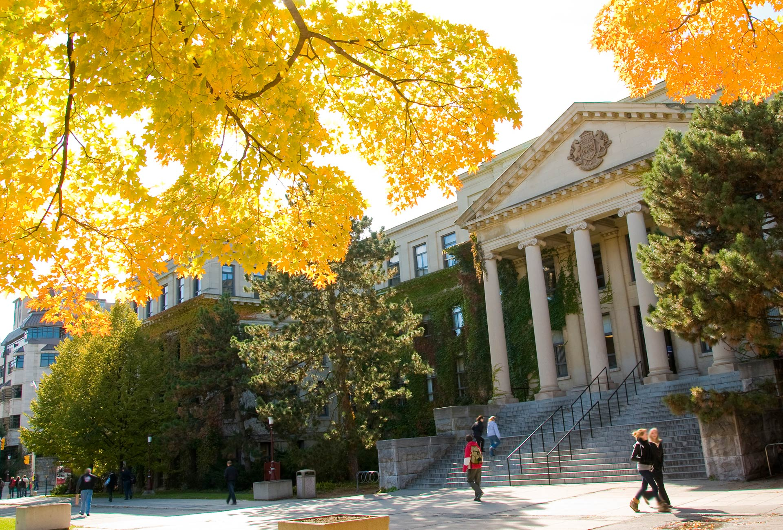
“GIVING BACK TO THE COMMUNITY”:
YOUNG AND ESTABLISHED LEADERS’ PERSPECTIVES OF THEIR CONTRIBUTIONS TO THE ARCTIC WINTER GAMES
Steph MacKay and Christine Dallaire
uOttawa.ca

Slide 2
Context: Larger Project on Giving Back
Explores experiences of adults who give back to their communities
Case studies (3) focus on community partners that run sport programs for youths and attract former participants as volunteers or employees
Research Questions:
How young adults (and older adults in the case of the Arctic Winter Games) involved as program leaders conceive of the “community”
What motivates their engagement
How they make sense of their leadership responsibilities and their own actions
WHAT: To whom do people give back to? Why do they do it?
IMPLICATIONS FOR INDIVIDUALS: Does giving back help people have a heightened sense of belonging to their communities?
IMPLICATIONS FOR SPORTS SYSTEM AND SOCIETY: Can organizations and communities foster the notion of giving back?
Notes:
Explores experiences of adults who give back to their communities, whether the community in question is a cultural, organizational, regional, gender or other “community”
Case studies (3) focus on community partners that run sport programs for youths and attract former participants as volunteers or employees
Research Questions:
How young adults (and older adults in the case of the Arctic Winter Games) involved as program leaders conceive of the “community”
What motivates their engagement
How they make sense of their leadership responsibilities and their own actions
WHAT: To whom do people give back to? Why do they do it?
IMPLICATIONS FOR INDIVIDUALS: Does giving back help people have a heightened sense of belonging to their communities?
IMPLICATIONS FOR SPORTS SYSTEM AND SOCIETY: Can organizations and communities foster the notion of giving back?

Slide 3
Methods
Semi Structured interviews (19) conducted with:
5 Managers and/or Board Members – AWGIC (“managers”)
8 Contingent leaders (mission staff, officials) and experienced coaches – AWG (“contingent leaders”)
6 Young coaches (aged 22-36) – AWG (“young leaders”)
All interviews were conducted by Christine Dallaire, along with Salman Alavi as an observer (for most), between November 2022 and February 2023 and were digitally recorded and transcribed.
Pseudonyms were assigned to each interview participant.
Some managers and contingent leaders were employees (paid by provincial governments, sport organizations, the AWGIC or the Host Society), while others from these groups and all the young leaders were volunteers.
The focus on former AWG participants considered “champions” of civic engagement within the organization means that their views may not be representative of all leaders and managers.
Notes:
Semi Structured interviews (19) conducted with:
5 Managers and/or Board Members – AWGIC (“managers”)
8 Contingent leaders (mission staff, officials) and experienced coaches – AWG (“contingent leaders”)
6 Young coaches (aged 22-36) – AWG (“young leaders”)
We included older, established leaders in the main body of work in this case because of the limitations we faced resulting from the global COVID-19 pandemic. To maintain the project, we recruited young and established leaders to take part in interviews, most of whom are former participants of the AWG, working as volunteers (committee members, mission staff, managers, coaches, officials, etc.) and see their involvement in the AWG as a way to give back to the AWG and the greater circumpolar North community.
All interviews were conducted by Christine Dallaire, along with Salman Alavi as an observer (for most), between November 2022 and February 2022 and were digitally recorded and transcribed.
Pseudonyms were assigned to each interview participant.
Some managers and contingent leaders were employees (paid by provincial governments, sport organizations, the AWGIC or the Host Society), while others from these groups and all the young leaders were volunteers.
For the paid employees, their work with the AWG was thus part of their job, however as explained in their interviews, their involvement and commitment to community development clearly extends beyond their “jobs” to the point of sacrifice and selflessness seen in community engagement (Willemez, 2013) and other youth association work (Dallaire, 2017) and thus can be (and is, in this report) compared to the involvement of the volunteers.
The interviews with managers, contingent leaders and young leaders provided us with rich data and interesting findings presented in this report and in academic articles (in progress). The depth and relevance of the data collected is a direct result of the generosity and engagement of former participants involved in various roles with the AWG. It is their commitment to the AWG that motivated their participation in the interviews which ensured depth and authentic reflection in the interview conversations. This purposeful recruitment served the overall research project’s objective of gaining a better understanding of young (and in this case, established) leaders’ engagement by exploring the experiences of leaders currently involved in community development through their leadership roles in the AWG. However, the focus on former AWG participants considered “champions” of civic engagement within the organization means that their views may not be representative of all leaders and managers who have worked or who are currently working for the AWG. This research report does not offer an overall assessment of all AWG worker and volunteer experiences.

Slide 4
Research Question #1 Giving Back to What Community?
What discourses of “community” do the managers, contingent leaders and young leaders draw on to describe the AWG and their place within it?
What are the AWG?
What community are they working with? The AWG? The Circumpolar North? The region in which they live? A specific group?
How do they situate themselves in this community? What is their sense of belonging?
Notes:
What discourses of “community” do the managers, contingent leaders and young leaders draw on to describe the AWG and their place within it?
What are the AWG?
What community are they working with? The AWG? The Circumpolar North? The region in which they live? A specific group?
How do they situate themselves in this community? What is their sense of belonging?

Slide 5
Findings Giving Back to What Community?
What are the AWG?
When asked to describe the AWG, interview participants did not explicitly use the word “community”. Instead, they identified 40 themes, which suggests that the AWG represent different things to different people.
More than half of the interview participants discussed the level of competition.
Almost all interview participants referenced cultural exchange aspects.
Thirteen interview participants spoke about social interchange aspects of the AWG, by referencing friendships that develop between participants or interactions that occur (especially during pin and clothing trading).
Descriptions of the AWG were aligned with the three rings of the logo and their comparisons to other major games suggest the AWG are “friendlier”.
Notes:
While it is remarkable that researchers and those involved with the governance and organization of the AWG deem them a community, if we go with Bessant’s notion that communities are constructed by people, it is also important to find out how the people involved with the everyday operations of the AWG feel about it. How do the leaders and managers who make the AWG happen understand it? What discourses of community do the managers, contingent leaders and young coaches draw on to describe the AWG and their place within it? In other words, what are the AWG?
When asked to describe the AWG, interview participants did not explicitly use the word “community”. Instead, they identified 40 themes, which suggests that the AWG represent different things to different people. Many themes were related, and thus grouped together in the analysis
More than half of the interview participants discussed the level of competition at the AWG, in some way, with most of them explaining that while it is a lower level than competitions that include athletes south of the 55th parallel, such as Canada Games, it is a high (and appropriate) level for Northern athletes – there is parity amongst participants
Additionally, when asked how they would describe the AWGs, almost all 19 interview participants referenced cultural exchange aspects of the AWG, which represents the second ring of the AWG logo. Some participants spoke about the importance of the cultural sports (including the Arctic Games and Dene Games) and events (including the Cultural Gala, art show and aspects of the Opening and Closing ceremonies). Other participants pointed to the destination feature of the AWG, where athletes travel (often great distances) outside of their hometowns and experience different cultures by visiting other regions or even countries.
Thirteen of the 19 interview participants spoke about social interchange aspects of the AWG, by referencing friendships that develop between participants or interactions that occur (especially during pin and clothing trading).
Responses detailing athletic competition, cultural exhibition and social interchange fit with the mission of the AWG, as symbolized by the three interlocking rings of the AWG Official Logo. This suggests that the AWG’s mission is understood and being taken up by managers, contingent leaders and young leaders. However, given that the interview participants did not explicitly use the word “community” to describe the AWG, we dug deeper in the data to determine if (and where) discourses of community emerged.

Slide 6
Findings Giving Back to What Community?
b) What community are they working with?
The AWG are seen as a “community” by some.
Many spoke about "Northern pride" or “people of/in the North”.
When speaking about the AWG as a community, some troubled the concept.
While the sentiment of a community consisting of all “people of the North” is presented and promoted, it is hard to achieve when national/regional communities (and identities) are also strongly promoted.
Most do not see the AWG as the community to which they are giving back. Instead, they claimed to be giving back to the local community in which they live, young athletes in general or the athletes they work with specifically, and their sport community (including coaches, volunteers, parents).
Different communities were identified but most were giving back (at least in part) because of a commitment to social justice
Notes:
b) The friendships and social exchanges described arguably construct a sense of community, which more than half of the interview participants spoke about. One manager used the term “Northern pride” to describe this sense of community (Sean, Manager). Many interview participants spoke about this sense of community using different terminology, such as “people of/in the North”. Within their responses, participants explained that people of/in the North have deep experiences in common, which humble them, such as living in cold (and often harsh) climates with very few amenities (which can require travelling long distances to access). These common experiences act like a glue that binds people together. For example, Colette (Contingent Leader) describes “people in the North” and Kit (Contingent Leader) suggests that “we’re all in the same boat”:
However, often when speaking about the AWG as a community, interview participants troubled the concept. For example, Melly (Young Leader) suggests that the AWG create / build a community around the games at large, while, at the same time, create / strengthen smaller communities that come to the AWG: FLIP TO QUOTE
When interview participants spoke about the AWG community and/or a panarctic community and their regional community (and the identities tied to those communities), while subtle, it became clear that attempts to create a panarctic identity are challenged rather than promoted when contingents are separated visually (e.g., using uniforms) and through the competitive format of most athletic events at the Games. Indeed, Thomsen et al. (2018) suggest that at the AWG “panarcticism and nationalism/regionalism are clearly enrolled in an intricate and frictious relationship” (p. 112). While appearing as though they are multiple and complimentary identities and “although panarctic identity building is an explicit purpose of the games—as stated in the AWG constitution—participants and spectators . . .enacted parallel and contrasting identities in a seemingly knee-jerk relapse to national/regional positioning (Thomsen et al. p. 111). In other words, while the sentiment of a community consisting of all “people of the North” is presented and promoted, it is hard to achieve when national/regional communities (and identities) are strongly promoted, as well. However, that most interview participants referred to multiple communities (and identities tied to those communities) rather than contradictory identities suggests that the AWG offers a milieu that allows the manifestation of a sense of belonging to more than one group – it does not expect participants to commit only to a panarctic community (and identity) while at the Games, despite some attempts to create such a community (see Thomsen, et al., 2018).
Interview participants also explained how they see the community to which they are contributing. Interestingly, despite having unanimously positive descriptions of the AWG (with a few explicitly identifying the AWG as a community in this question), they rarely identified the AWG as the community to which they felt they were giving back to. In other words, while interview participants spoke about people of/in the North, the struggles that bind them together, and the AWG as a community in and of itself, they did not see the AWG as the community to which they were contributing. The communities they most often identified include: the local community in which they live, young athletes in general or the young athletes they work with specifically, and their sport community (including coaches, volunteers, parents).
It is important to recognize, here, that although the interview participants claimed to be giving back to different communities, most were giving back (at least in part) because of a commitment to social justice. Darnell and Millington (2019) suggest that sport can serve as a space for addressing issues related to social justice. In the case of the AWG, while it may be that white privileged people occupy most Chefs de Mission and contingent leader positions, and while interview participants in these positions had a different mix of communities to which they felt they were giving back to, there was a true concern and at least effort by most to ensure that all youths (including less privileged youth) have access to the AWG (one interview participant, Mairin spoke explicitly to this point). Importantly, this is not new to the AWG. Peoples’ primary motivations for contributing to community projects are often related to social justice values (see Basok et al. 2002). Research (see Einfeld & Collins, 2008) further suggests that educating community project volunteers on social justice issues is crucial for pushing those agendas forward. We will return to this later.

Slide 7
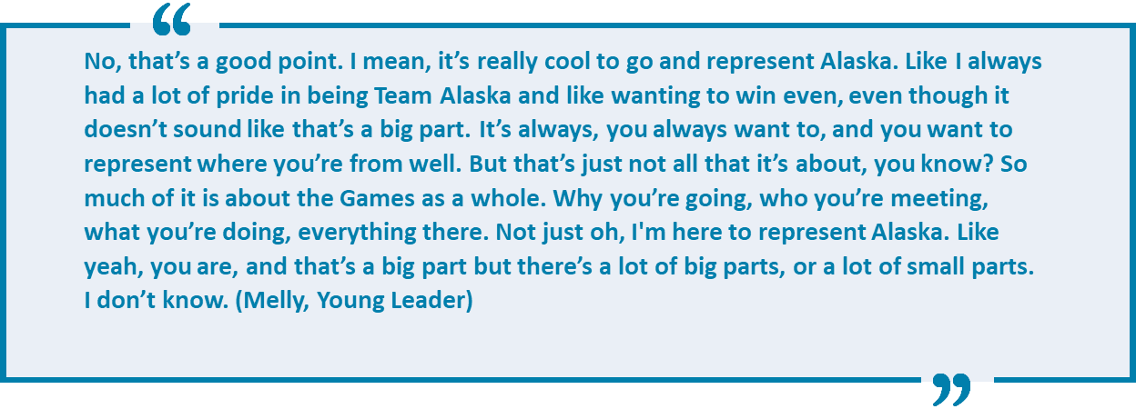
Findings Giving Back to What Community?

Slide 8
Findings Giving Back to What Community?
c) What is their sense of belonging?
Eight interview participants stated one community or group to which they most strongly felt a sense of belonging. Eleven participants felt a sense of belonging to more than one community.
Their strongest sense of belonging was to the community in which they live, to their province / territory / state, to their Arctic Winter Games contingent or to their sport club, their sport, or sport in general, rather than the AWG.
Multiple identities came up for 14 interview participants while contradictory identities (see Thomsen et al., 2018) came up for some, which impacted their sense of belonging.
Notes:
c) Participants also described the community to which they felt the strongest sense of belonging.
Eight interview participants stated one community or group to which they most strongly felt a sense of belonging. Eleven participants felt a sense of belonging to more than one community.
The most common responses include feeling a sense of belonging to the community in which they live, to their province / territory / state, to their Arctic Winter Games contingent or to their sport club, their sport, or sport in general.
Multiple identities came up for many interview participants while contradictory identities (see Thomsen et al., 2018) came up for some, which impacted their sense of belonging.

Slide 9
Lines of Inquiry – Research Q #1 Giving Back to What Community?
How can AWG attract former participants to engage in the future, knowing more about how people perceive the concept of community?
Does the AWG want to be seen as a community unto itself, or is it more about using the AWG to construct a panarctic community (and identity)?
Does the AWG want to be the “community” to which leaders come and contribute to?
Would it be more productive for the AWG to strive to promote itself as fostering multiple identities and giving back to multiple communities?
Notes:
How can AWG attract former participants to engage in the future, knowing more about how people perceive the concept of community?
Does the AWG want to be seen as a community unto itself, or is it more about using the AWG to construct a panarctic community (and identity)?
Does the AWG want to be the “community” to which leaders come and contribute to?
Would it be more productive for the AWG to strive to promote itself as fostering multiple identities and giving back to multiple communities?

Slide 10
Research Question #2 Experiences and Motivations
What are the AWG managers, contingent leaders, and young leaders’ motivations?
How have the managers, contingent leaders and young leaders’ experiences sparked their desire to give back?
Do they conceive of their work as community engagement? How?
How are they recruited?
What kind of training takes place?
Notes:
What are the AWG managers, contingent leaders, and young leaders’ motivations?
How have the managers, contingent leaders and young leaders’ experiences sparked their desire to give back?
Do they conceive of their work as community engagement? How?
How are they recruited?
What kind of training takes place?

Slide 11
Findings Experiences and Motivations
How have their experiences sparked their desire to give back?
Former participants had mostly positive experiences, few negative experiences
Participants' fondest memories were related to the “meaningful” athletic competition, the cultural exchanges, and the friendly ambiance, all of which connect with the mission of the AWG (three rings).
One person's special memory was that participants were made to feel like part of something bigger than themselves, as though the AWG is an invisible entity that englobes anyone who participates – a nod to notion of community.
When asked what they remembered most, ten (10) participants spoke about their development as an athlete.
When asked what they liked most, only three (3) mentioned sport while over half spoke about social interactions.
They had a multitude of motivations for getting involved, with 8 of 13 returning to give back.
Notes:
Former participants had mostly positive experiences of the AWG, with very few negative experiences to report.
Participants' fondest memories of the AWG were related to the “meaningful” athletic competition, the cultural exchanges, and the friendly ambiance, all of which connect with the mission of the AWG (three rings).
One person's special memory was that participants were made to feel like part of something bigger than themselves, which paints a picture of the AWG as an invisible entity that englobes anyone who participates in any way – a nod to the notion of community.
Interestingly, when asked what they remembered most, 10 participants spoke about their development as an athlete. However, when asked what they liked the most, only 3 mentioned sport while over half spoke about social interactions.
They had a multitude of motivations for getting involved, with 8 of 13 returning to give back. FLIP TO QUOTE Colette (Contingent Leader) expresses her desire to give back but also her hope that their actions will encourage others to do the same in the future.
Many interview participants’ motivations can be brought back to the notion of social justice discussed earlier. Sport workers and volunteers attempt to develop (underprivileged) youth by harnessing the transformational benefits of sport. Ultimately, it appears as though the leaders’ motivations have strong links with how they think about or see the AWG.
Furthermore, the varied responses explaining why they wanted to (in most cases, return, after previously participating, to) work for the AWG indicate that the reasons for giving back are diverse. This is a predictable finding, given people have different relationships to the AWG. Given this predictability, why bother exploring AWG managers, contingent leaders, and young leaders’ motivations, anyways? Scholars exploring the motivations of volunteers in large scale events, community sports organizations and events and even Sport for Development and Peace (SDP) projects suggest an important purpose of their research is to help sport managers effectively manage the volunteer experience (i.e., ensuring volunteers are effective in their roles and satisfied with their experience) and, ultimately, understand how to develop better recruitment, training and retention strategies – in other words, in this case, how to keep the AWG going, a crucial task as referenced by many of the interview participants.

Slide 12
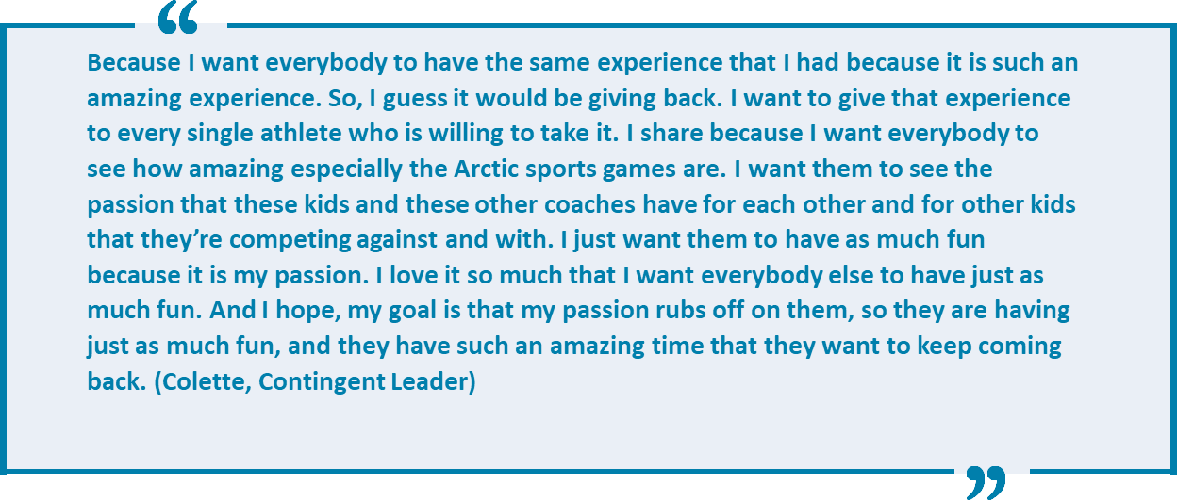
Findings Experiences and Motivations

Slide 13
Findings Experiences and Motivations
b) Do they conceive of their work as community engagement? How?
This giving back was not explicitly seen as community engagement, and it most often happened due to feelings of both reciprocation and responsibility.
Reciprocation happened when leaders contributed their time and energy with the goal of “paying it back” to those who contributed to their positive experiences or “paying it forward” to current members or participants.
Responsibility is defined as " to act out of commitment to do what one thinks is right, what will promote public welfare, quite apart from whether it promotes one's own. It is to act out of a sense of responsibility as a citizen” (Swartz, 1993, p.337). Wray-Lake and Syvertsen (2011) also connect responsibility to citizenship and add that it motivates certain behaviours rooted in justice and care for others.
Two participants discussed that they were reciprocating, 4 felt responsible and 7 felt they were doing both to ensure that the AWG continue.
Notes:
b) While no one explicitly identified community engagement as their motivation to work or volunteer for the AWG, given that most responses referenced a desire to make a difference in the day-to-day life of people around them suggests that their work does, indeed, consist of community engagement. But they didn't see it that way.
This giving back was not explicitly seen as community engagement, and it most often happened due to feelings of both reciprocation and responsibility.
Our findings suggest that managers, contingent leaders and young leaders contribute their time and energy with the goal of “paying it back” to the organization or community (known as direct upstream reciprocity) or “pay it forward” to current members or participants (known as indirect upstream reciprocity)14. However, feelings of social responsibility to act played into the interview participant’s motivations to give back, as well. Schwartz (1993) states that social responsibility is "to act out of commitment to do what one thinks is right, what will promote public welfare, quite apart from whether it promotes one's own. It is to act out of a sense of responsibility as a citizen” (p.337). Wray-Lake and Syvertsen (2011) also connect social responsibility to citizenship and add that it motivates certain behaviours rooted in justice and care for others. Giving back, the result, is therefore not simply motivated by either the characteristic of reciprocity or the act of reciprocation. It is also connected to the characteristic of responsibility and thus required a nuanced analysis.
We felt it was important to determine whether the interview participants were giving back because of a sense of reciprocation or responsibility, to know, at a deep level, what was driving interview participants to give their time and energy to the AWG.
Two participants discussed that they were reciprocating, 4 felt responsible and 7 felt they were doing both to ensure that the AWG continue. This is an interesting finding given that so many of the interview participants initially seemed to understand giving back only as reciprocation. The act of asking the interview participants this question incited reflexivity on their part, which many suggested was something they benefitted from.

Slide 14
Findings Experiences and Motivations
c) How are they recruited?
Very few interview participants indicated that they had been recruited, which suggests that they were drawn to give back on their own.
Those that were recruited were asked by either friends, family members or acquaintances they had made at previous AWG as participants or in other roles on sport governing bodies or organizations
Those that were not recruited applied for their positions because they wanted to return to the AWG in some capacity. This speaks to their self-motivation to return to the AWG.
Notes:
How are they recruited?
Very few interview participants indicated that they had been recruited, which suggests that they were drawn to give back on their own.
Those that were recruited were asked by either friends, family members or acquaintances they had made at previous AWG as participants or in other roles on sport governing bodies or organizations.
Those that were not recruited applied for their positions because they wanted to return to the AWG in some capacity. This speaks to their self-motivation to return to the AWG.

Slide 15
Findings Experiences and Motivations
d) What kind of training takes place?
When asked “what kind of training did you receive with respect to the mission and values of the AWG or your contingent”, most mentioned the technical or logistical or conduct training they had received (either from AWG managers or sport specific organizations) rather than anything related to the mission and values.
When managers were asked “what kind of training do you focus on”, most stated that while they had to train their coaches and volunteers on logistical aspects, they did not have to train them with respect to the mission and values of the AWG.
Notes:
What kind of training takes place?
When asked “what kind of training did you receive with respect to the mission and values of the AWG or your contingent”, most Contingent Leaders and Young Leaders mentioned the technical or logistical or conduct training they had received (either from AWG Managers or sport specific organizations) rather than anything related to the mission and values.
When managers were asked “what kind of training do you focus on”, most Managers and Contingent Leaders stated that while they had to train their coaches and volunteers on logistical aspects, they did not have to train them with respect to the mission and values of the AWG.
This is quite relevant and speaks to the success of the AWG in having a positive impact on young people such that they are self-motivated to return and for promoting their values among participants. With a more direct focus on reconciliation (at least in Canada), it is possible that more recruitment and training will be required in the future.

Slide 16
Lines of Inquiry – Research Q #2 Experiences and Motivations
Is the AWG trying to foster in its current participants a desire to give back? If so, how is this done now and what could help further foster the desire to give back?
Should recruitment be prioritized, especially for people who may not otherwise apply?
What about training? Should all those involved be trained with respect to social justice values? What would this look like? How might this address the Truth and Reconciliation Commission of Canada's Calls to Action?
Notes:
Is the AWG trying to foster in its current participants a desire to give back? If so, how is this done now and what could help further foster the desire to give back?
Should recruitment be prioritized, especially for people who may not otherwise apply?
What about training? Should all those involved be trained with respect to social justice values? What would this look like? How might this address the Truth and Reconciliation Commission of Canada's Calls to Action?

Slide 17
Research Question #3 Upholding the Mission & Values of the AWG
What meanings do managers, contingent leaders and young leaders ascribe to their sporting responsibilities as practices of engagement towards youth and the “community”, beyond a love of sport?
What are the mission and values of the AWG?
Do the AWG have a social responsibility?
Who are the AWG for?
What are their goals?
What kind of person do they want to be?

Slide 18
Findings Upholding the Mission & Values of the AWG
What are the mission and values of the AWG?
Eleven (11) interview participants' responses referenced sport, with most suggesting the development of young athletes as the focus.
Eleven (11) also referenced culture, particularly their focus on cultural awareness.
In fact, most claimed that the AWG were about both sport and culture.
Five (5) interview participants spoke of fair play.
Seven (7) people referred to community development and connection between people.
Three (3) interview participants suggested that the AWG are a catalyst for life
Notes:
What are the mission and values of the AWG?
Eleven (11) interview participants' responses referenced sport, with most suggesting the development of young athletes as the focus.
Eleven (11) also referenced culture, particularly their focus on cultural awareness.
In fact, most claimed that the AWG were about both sport and culture.
Five (5) interview participants spoke of fair play.
Seven (7) people referred to community development and connection between people.
Three (3) interview participants suggested that the AWG are a catalyst for life
Interview participants know what the AWG stands for and their views of the mission and values are congruous with the AWGIC and Host Societies.
Interview participants thus seem to be upholding the AWG mission and values – cultural awareness and understanding, fairplay, access and equity, integrity, respect for self and others, partnerships, personal development and community development – FLIP TO QUOTE

Slide 19
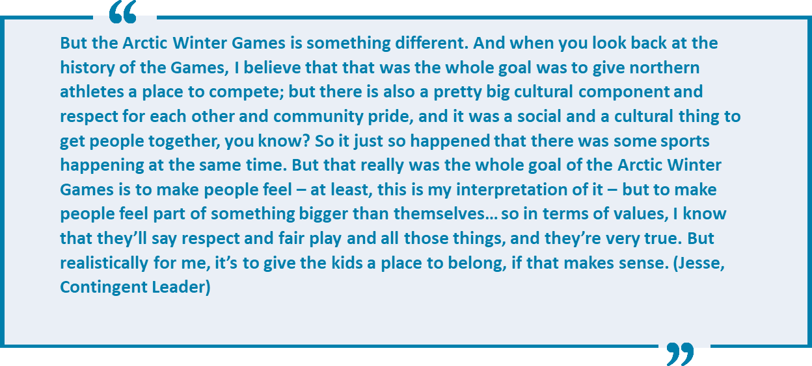
Findings Upholding the Mission & Values of the AWG

Slide 20
Findings Upholding the Mission & Values of the AWG
b) Do the AWG have a social responsibility?
Widely agreed that the AWG have a social responsibility
Interview participants indicated that the AWG have a social responsibility, with 12 suggesting two or more aspects of social responsibility
Six (6) felt one responsibility was to give people (specifically children living in Northern communities in general and athletes from small communities in particular) the opportunity to a) experience the AWG; and b) take their experiences back to their communities
Seven (7) participants confirmed that the AWG are about more than sport and culture. One Manager claimed that the AWG should have “far-reaching tentacles” out to communities of the North.
Other aspects of social responsibility include: celebrating culture, giving people the opportunity to learn about culture, developing young athletes, preserving Arctic sports and building relationships between people of the North.
Notes:
Of note – sport researchers have only recently begun to address the concept of social responsibility in sport organizations, with most applying corporate social responsibility frameworks to understand community sport organizations (see Robertson et al., 2019). These studies have found that community sport organizations, like those involved with the AWG, are perceived to have a wide range of social responsibilities. We avoided using any frameworks or definitions of social responsibility in the interviews and simply asked interview participants whether they believed the AWG have some kind of social responsibility towards others.
It was widely agreed that the AWG have a social responsibility, with 17 interview participants speaking about this.
Twelve people suggested two or more aspects of social responsibility that AWG have.
Six (6) felt one responsibility was to give people, in particular children living in Northern communities in general and athletes from small communities in particular the opportunity to a) experience the AWG; b) take their experiences back to their communities
Seven participants confirmed that the AWG are about more than sport and culture. For example, Mairin (Manager) claims that the AWG should have “far-reaching tentacles” out to communities of the North:
Others claimed that the social responsibility aspects of the AWG include: celebrating culture, giving people the opportunity to learn about culture, developing young athletes, preserving Arctic sports and building relationships between people of the North..

Slide 21
Findings Upholding the Mission & Values of the AWG
c) Who are the AWG for?
Almost all interview participants believed the AWG were for the athletes
Others believe that they are for “everyone” or the “whole community”
Many people gave multiple answers, including responses such as cultural participants, adults, host communities, Indigenous athletes, spectators, elders, politicians / funders.
One participant suggested that the AWGIC should better define whether the AWG are for the highest performing athletes or for those who want to participate, regardless of competency. This was an interesting finding, and one that we suggest AWGIC continue to address.
Notes:
Who are the AWG for?
Almost all interview participants believed the AWG were for the athletes
Others believe that they are for “everyone” or the “whole community”
Many people gave multiple answers, including responses such as cultural participants, adults, host communities, Indigenous athletes, spectators, elders, politicians / funders.
One participant suggested that the AWGIC should better define whether the AWG are for the highest performing athletes or for those who want to participate, regardless of competency. This was an interesting finding, and one that we suggest AWGIC continue to address.

Slide 22
Findings Upholding the Mission & Values of the AWG
d) What are their goals?
Fourteen (14) participants had multiple goals for their involvement.
Nine (9) stated that their primary goal was to help AWG participants understand that winning and competition are not the most important thing
Eight (8) stated that a goal was to help give participants an experience that will last a lifetime
Six (6) suggested they wanted participants to have fun
Other goals include: encouraging youth, being a role model, preserving the integrity of the AWG (i.e., the size of the event, the values), providing a safe environment, preparing athletes well, aspects of reconciliation, sharing the passion, keep AWG going, teaching and embodying hard work, a positive attitude and fair play, make family proud and convincing youth to give back.
Notes:
What are their goals?
Fourteen (14) participants had multiple goals for their involvement.
Nine (9) stated that their primary goal was to help AWG participants understand that winning and competition are not the most important thing
Eight (8) stated that a goal was to help give participants an experience that will last a lifetime
Six (6) suggested they wanted participants to have fun
Other goals include: encouraging youth, being a role model, preserving the integrity of the AWG (i.e., the size of the event, the values), providing a safe environment, preparing athletes well, some aspects of reconciliation, sharing the passion, keep AWG going, teaching and embodying hard work, a positive attitude and fair play, make family proud and convincing youth to give back
The concept of youth development popped up (unsolicited) in many responses throughout the interviews, including when interview participants were asked to describe the AWG. In that case, seven participants spoke about how the AWG provide athletes with the opportunity to travel (often far distances). Comments referred to the fact that AWG is often the first (and sometimes only) large scale sporting experience athletes of the North get, particularly for those who might not have the opportunity to travel to other athletic competitions. One interview participant even called it a “grown-up experience”, which is suggestive of youth development. Positive Youth Development (PYD) is a framework that has been used in many disciplines (including sport) to explain the psychosocial development of young people, with sport researchers using it to explain how sport can be a learning environment for acquiring physical (e.g., skills for healthy active living), personal (e.g., positive self-perceptions), and social (e.g., civic engagement) life skills (Camire, et al. 2021). Proponents of the framework continue to emphasize that sport can help with individual skill building, engagement, and empowerment.
While the AWG thus seems to be a milieu in which PYD is taking place, it is also a place in which Social Justice Youth Development (SJYD) may (or may not yet be) taking place. Importantly, SJYD, which builds youth’s self-awareness of how class, gender, race, ethnicity, and other dimensions of power affect their lives and contribute to the root causes of both local and global challenges (see Camire et al, 2021; Iwasaki et al., 2014) is becoming valued in a youth sport setting. Given that some interview participants commented about hoping to instill responsibility, accountability and sacrifice through her work with AWG participants, the time seems right for the AWG to continue to push forward with a focus on SJYD. However, this requires a perpetual rethinking of their sport structures, and would require those involved with the governance of the AWG to refashion aspects of the annual event.

Slide 23
Findings Upholding the Mission & Values of the AWG
e) What kind of person do they want to be?
Eight (8) interview participants stated that they wanted to be either role models or mentors
Other responses that were shared by multiple people include being a helpful person, an advocate, a leader who challenges people and someone who wants to share their passion for the AWG with others
It is relevant that interview participants had already reflected on the type of person they want to be through their involvement with the Games and all of them could speak to what could have been a difficult question.
Notes:
e) What kind of person do they want to be?
Eight (8) interview participants stated that they wanted to be either role models or mentors
It is relevant that interview participants had already reflected on the type of person they want to be through their involvement with the Games and all of them could speak to what could have been a difficult question.
Their thoughtful answers revealed that contributing to the AWG is meaningful to their sense of self, and not merely a habitual practise. It is a very deliberate engagement which relates to how they view the AWG as congruent with their goals and values but also as a site that allows community engagement.

Slide 24
Lines of Inquiry – Research Q #3 Upholding the Mission & Values of the AWG
In what ways do / can the AWG engage in the aspects of social responsibility suggested by interview participants?
What are your suggestions to enhance this engagement in the future?
How can the AWG continue to foster meaningful community engagement in ways that are congruent with their mission and values?
How can the AWG enable greater involvement in ways that ensure individual goals fit within the AWG mission and values?
Notes:
In what ways do / can the AWGs engage in the aspects of social responsibility suggested by interview participants?
What are your suggestions to enhance this engagement in the future?
How can the AWG continue to foster meaningful community engagement in ways that are congruent with their mission and values?
How can the AWG enable greater involvement in ways that ensure individual goals fit within the AWG mission and values?

Slide 25
Findings – Overall
AWG managers, contingent leaders and young leaders passionately work towards achieving the AWG mission, which is to present an athletic competition, a cultural exhibition and a venue to promote social inter-change (as symbolized by the three interlocking rings) for young Northern athletes, cultural participants, Northern communities and, arguably the panarctic community
The comparison of interviews with managers, contingent leaders and young leaders reveals consistency with respect to what the AWG represents
Notes:
AWG managers, contingent leaders and young leaders passionately work towards achieving the AWG mission, which is to present an athletic competition, a cultural exhibition and a venue to promote social inter-change (as symbolized by the three interlocking rings) for young Northern athletes, cultural participants, Northern communities and, arguably the panarctic community
The comparison of interviews with managers, contingent leaders and young leaders reveals consistency with respect to what the AWG represents

Slide 26
Discussion Questions – Big Picture Challenging the Sports System
Interview participants suggest that the AWG reproduce a lot of Olympic and other mega event aspects but challenge many other aspects.
Does the AWG want to be seen as a “community” that challenges other sporting communities, because it takes a “friendlier” approach to sport and physical activity and is more inclusive on many levels (e.g., inclusion of Arctic Sports and Dene Games)? If so:
What future actions are required? For example:
Organizers could look to True Sport, Jumpstart (Canadian resources), Aspen Institute's Project Play (US resource) and other organizations and research projects that are both questioning and challenging hypercompetitive aspects of sport
Discussions about whether those involved with the AWG want to enact an “alternative model” and figure out steps to achieve this
Notes:
Interview participants suggest that the AWG reproduce a lot of Olympic and other mega event aspects but challenge many other aspects.
Does the AWG want to be seen as a “community” that challenges other sporting communities, because it takes a “friendlier” approach to sport and physical activity and is more inclusive on many levels (e.g., inclusion of Arctic Sports and Dene Games)? If so:
What future actions are required? For example:
Organizers could look to True Sport, Jumpstart, and other organizations and research projects that are both questioning and challenging hypercompetitive aspects of sport
In 2023, the AWG was deemed a True Sport event, which means they committed to incorporating the True Sport Principles into all aspects of the event. Some aspects of this designation refer to community building, such as the "Include Everyone” and “Give Back” principles. However, it is important that the AWG consider what they are truly trying to achieve, with respect to notions of community and identity within the global sporting world.
Discussions about whether those involved with the AWG want to enact an “alternative model” and figure out steps to achieve this
Researchers suggest that “instead of trying to fit social justice agendas into market-driven youth sport structures, perhaps a rethinking of organized youth sport may be warranted for alternative modes of human movement to at least be acknowledged as offering worthwhile opportunities to promote social justice” (Atkinson, 2010)

Slide 27
Discussion Questions – Big Picture AWG and Reconciliation
While the AWG arguably started as a project with a colonial history and consciousness, it now has the opportunity to focus on inclusivity and building collective community through a commitment to the Truth and Reconciliation of Canada's Calls to Action
Is this a priority? And for whom? (AWGIC, host societies, contingents)
Host Societies can certainly make space to continue raising awareness and encouraging meaningful exchange on Indigenous issues through the sociocultural program and by involving local communities and peoples in the planning process
How are contingents engaging with these issues?
In what ways can contingents further engage on the path to reconciliation through diverse recruitment on the sport teams?
Are there best practices in some sports or in some contingents that can be shared and adapted throughout the various contingents to ensure that the AWG become a real opportunity for athletes in remote communities?
Notes:
–Not many interview participants discussed indigenous aspects of the AWG but individuals clearly experience it (see Thomsen, et al. 2018) and it’s very prevalent in both the national news (e.g., CBC coverage) and the Games news (The Ulu News).
While the AWG arguably started as a project with a colonial history and consciousness, it now has the opportunity to focus on inclusivity and building collective community through a commitment to the Truth and Reconciliation of Canada's Calls to Action
Is this a priority? And for whom?
Host Societies can certainly make space to continue raising awareness and encouraging meaningful exchange on Indigenous issues through the sociocultural program and by involving local communities and peoples in the planning process
How are contingents engaging with these issues?
In what ways can contingents further engage on the path to reconciliation through diverse recruitment on the sport teams?
Are there best practices in some sports or in some contingents that can be shared and adapted throughout the various contingents to ensure that the AWG become a real opportunity for athletes in remote communities?

Slide 28
Merci!
Thank you.
uOttawa.ca

